Slide 1
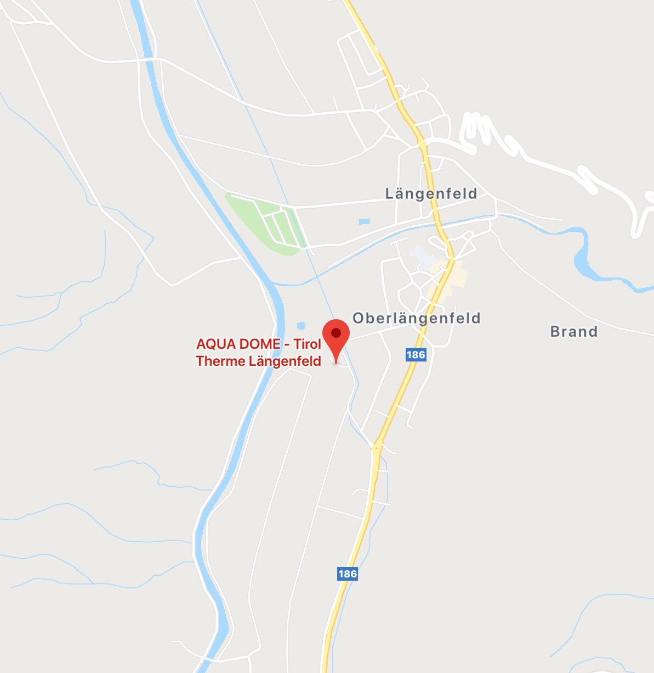
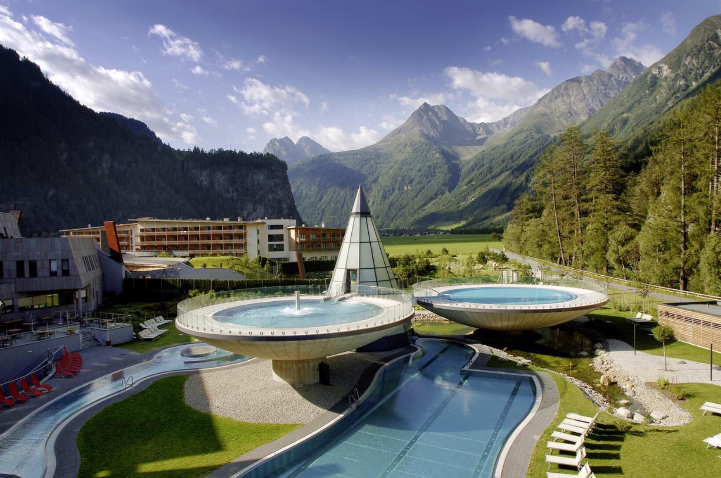
Aquadome
Ober Langenfeld n. 140, Austria
+43 52536400
Thermaninfo@aqua-dome.at
STRESSED? DON’T WORRY, HERE YOU CAN CHILL OUT

Slide 2
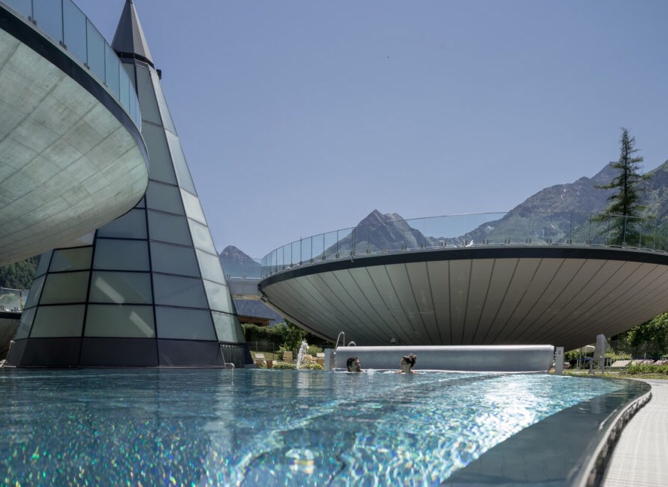
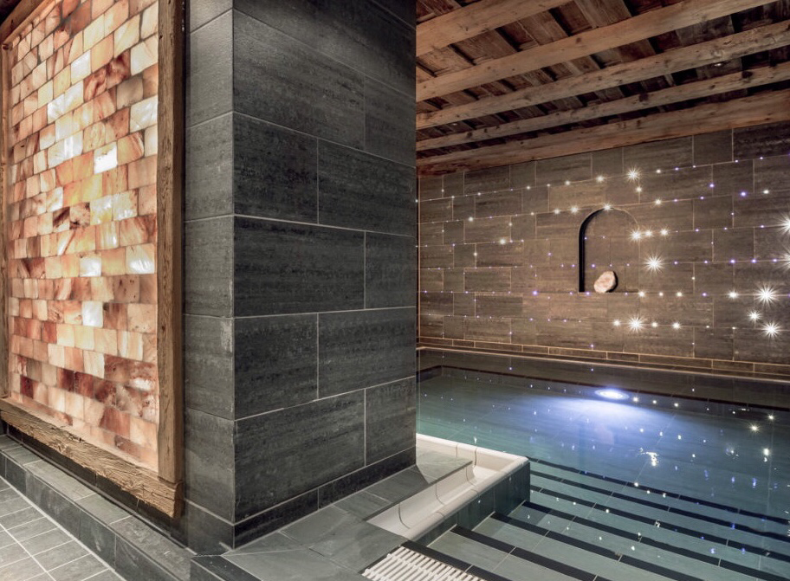
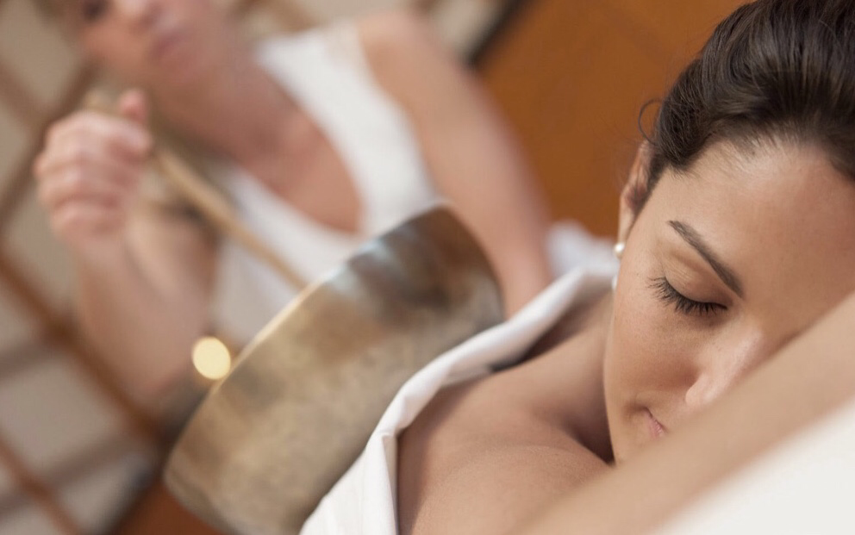
FACILITIES:
Thermal spa area:
Sauna area:
Origin of the thermal spa dome
River basic
Basic pools
Sport pool
Summer ☀️ | Adult | Children (3-14) | Students – Ederly
3 hours | 21,50€ | 12,00€ | 19,50€
Daily | 28,50€ | 16,50€ | 26,00€
Evening | 21,50€ | 12€
Out side pool
Plunge pool
Sole saune
Kneipp bath
Panoramic mineral water
Out door sauna area
Water fall shower
Ice cave
Natural garden
Zirbenwarse
Mountain place
Law for Sun bathing
Winter ❄️ | Adult | Children (3-14) | Students - Ederly
3 hours | 25,50€ | 15,50€ | 23,00€
Daily | 33,50€ | 19,50€ | 30,00€
Evening | 25,50€ | 15,50€
TREATMENTS:
Thermal deep
Pampering moments
Feel-dood ceremonies
Classic massage
Regional recommendations
Partner treatments
§ Day ticket unlimited (thermal spa, sauna, gym) 45,50€ in the summer and 49,50€ in the winter
NO children §

